Slide 1

“AI – BASED WILDLIFE RECOGNITION SYSTEM ”
Project Presentation
ADT24SOCBD025 : Ashwin Girish Gudur
ADT24SOCBD014 : Aditya Madhukar Gholap
ADT24SOCBD021 : Arya Ajit Dhumal
ADT24SOCBD054 : Himank Rajesh Maheshwari
Guided by
Prof. Shrikant Dhage(Faculty Guide)
Department of Computer Science & Engineering, MITSOC, Loni Kalbhor

Slide 2
Outline
Introduction
Problem Statement
Objectives
Concepts & Methods
Literature Review
Identification of gaps & scope of work
Implementation
Reference
Q&A
Department of Computer Science & Engineering, MITSOC, Loni Kalbhor

Slide 3
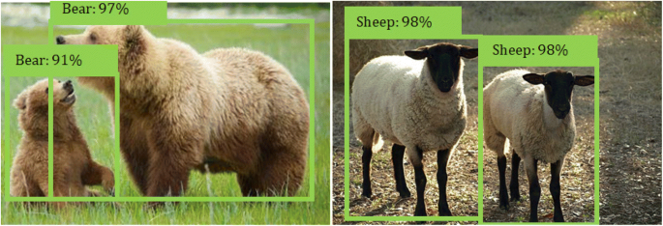
Introduction
Wildlife conservation is a crucial global challenge. Identifying species manually is time-consuming and prone to errors. The AI-Based Wildlife Recognition System leverages advanced algorithms to:
Recognize and classify wildlife species from images or videos.
Provide real-time data for researchers, conservationists, and enthusiasts.
Promote awareness and support biodiversity conservation efforts.
Department of Computer Science & Engineering, MITSOC, Loni Kalbhor

Slide 4
Problem Statement
Problem Statement:
Accurately identifying wildlife species is a critical challenge for researchers, conservationists, and wildlife enthusiasts. Traditional methods of species recognition are time-consuming, require expert knowledge, and are often inaccessible to the general public. Moreover, the lack of efficient tools for real-time monitoring, detailed species information, and public engagement hampers conservation efforts. This project aims to develop an AI-Based Wildlife Recognition System to address these challenges by providing an accurate, real-time, and user-friendly platform for species identification, education, and data collection, thereby promoting biodiversity awareness and supporting conservation initiatives.
1. Manual species identification is time-consuming and inaccessible to non-experts.
2. Existing tools lack real-time monitoring capabilities.
3. Insufficient access to accurate and organized species data.
4. Challenges in identifying species from poor-quality images.
5. Limited public awareness and engagement in conservation efforts.
Department of Computer Science & Engineering, MITSOC, Loni Kalbhor

Slide 5
Objectives
Develop an efficient AI-based wildlife recognition system capable of accurately identifying various species.
Enhance community engagement in wildlife conservation efforts through user_x0002_friendly interfaces and educational materials.
Improve species monitoring and data collection to facilitate informed
conservation decisions.
4. foster collaboration between technology experts, conservationists, and local communities to address pressing environmental challenges.
Department of Computer Science & Engineering, MITSOC, Loni Kalbhor

Slide 6
4. Concepts and Methods
Data Quality: Need for diverse and high-quality image datasets for accurate training.
Model Accuracy: Ensuring the model works well in different environments and for various species.
Scalability: Making sure the system can handle more species and users.
Hardware Requirements: The system needs good hardware (like GPUs) for faster processing and predictions.
Ethical Concerns: Ensuring the data used respects privacy and doesn't harm wildlife.
Department of Computer Science & Engineering, MITSOC, Loni Kalbhor

Slide 7
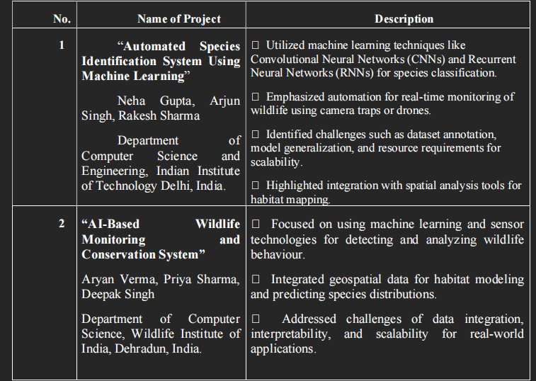
5. Literature Survey
Department of Computer Science & Engineering, MITSOC, Loni Kalbhor

Slide 8
Identification of gaps & scope of work
Identification of Gaps
1. Limited diversity in training datasets, leading to inaccurate identification of rare species.
2. High latency in real-time recognition, especially in low-resource environments.
3. Lack of integration with advanced hardware for real-time data collection.
4. Minimal features for user engagement and community contributions.
5. Insufficient database updates for new or evolving species information.
6. Limited scalability for handling large user bases or high data volumes.
7. Difficulty in identifying species in poor-quality images or challenging environmental conditions.
8. Absence of social sharing or collaborative tools to enhance community involvement.
Scope of Work
The proposed AI-Based Wildlife Recognition System represents a significant
advancement at the intersection of technology and wildlife conservation.
Leveraging state-of-the-art artificial intelligence techniques, this system aims to
revolutionize species identification and contribute to the preservation of
biodiversity worldwide.
Department of Computer Science & Engineering, MITSOC, Loni Kalbhor

Slide 9

8. Implementation / Results:
Department of Computer Science & Engineering, MITSOC, Loni Kalbhor

Slide 10
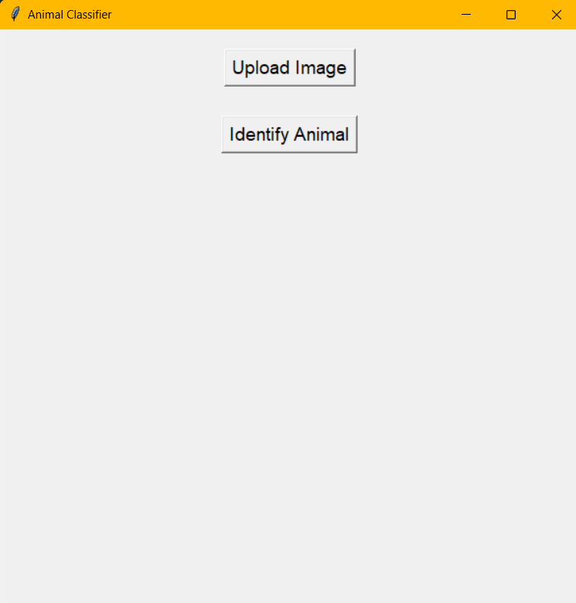
8. Implementation / Results:
Department of Computer Science & Engineering, MITSOC, Loni Kalbhor

Slide 11
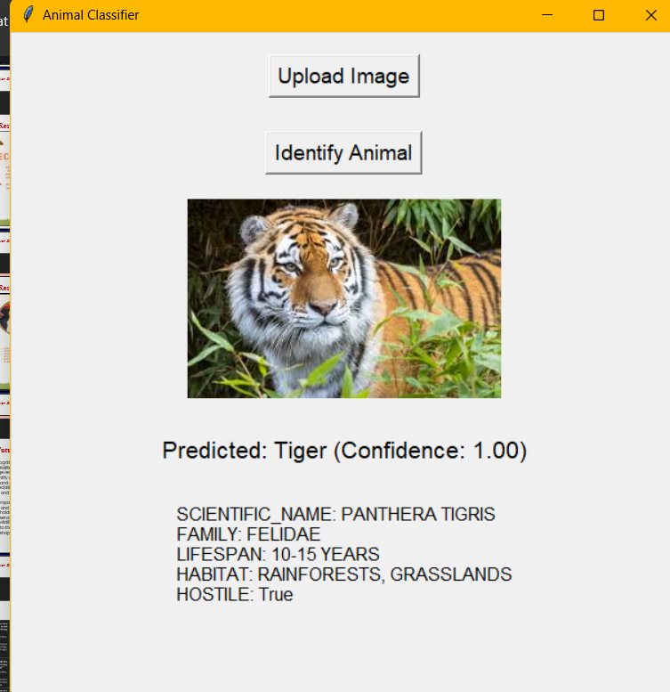
8. Implementation / Results:
Department of Computer Science & Engineering, MITSOC, Loni Kalbhor

Slide 12
10. Conclusion and Future Work
In conclusion, the Wildlife Recognition System represents a significant advancement in the field of wildlife identification and conservation. By harnessing the power of image recognition technology, the system empowers users to easily identify and learn about diverse wildlife species. Through its intuitive interface and comprehensive database, it facilitates greater awareness and appreciation of biodiversity, fostering a deeper connection between humans and the natural world.
Looking ahead, the potential impact of the Wildlife Recognition System is vast. As it continues to evolve and incorporate advancements in machine learning and data analysis, it holds promise for broader applications in research, education, and conservation initiatives. By engaging users in meaningful interactions with wildlife data, the system has the potential to inspire action and contribute to the preservation of endangered species and their habitats, ultimately shaping a more sustainable future for our planet.
Department of Computer Science & Engineering, MITSOC, Loni Kalbhor

Slide 13
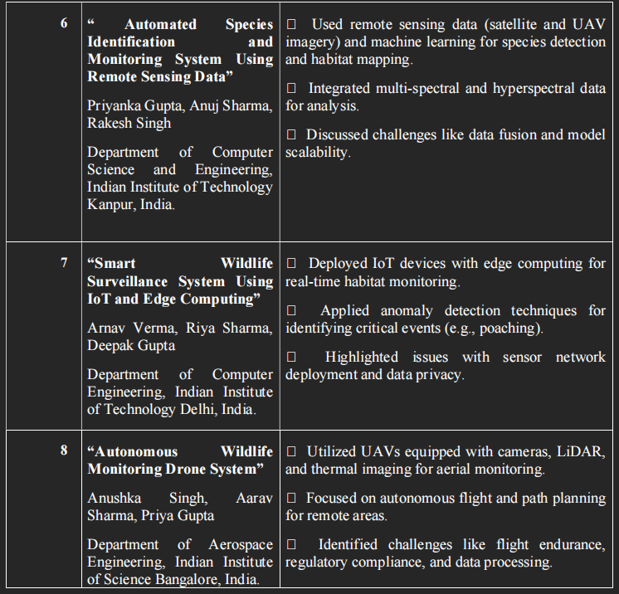
References
Department of Computer Science & Engineering, MITSOC, Loni Kalbhor

Slide 14
Tools and Languages
Programming Languages and Frameworks:
Python: For backend development and implementing AI models.
Tkinter: For creating the desktop application.
JSON : used to store data related to wildlife.
AI/ML Tools:
Tensorflow: For object detection and species identification.
Keras/TensorFlow: For model training and deployment.
Department of Computer Science & Engineering, MITSOC, Loni Kalbhor

Slide 15
Thank You
Department of Computer Science & Engineering, MITSOC, Loni Kalbhor

